Slide 1







Insightify_Full
AI Review Analyzer
Presented by: Ghinwa Allaoui
Tutor: Mulham Fetna, Mentor: Jaafer Mahfoud
Women in Tech Program - Paper Airplanes

Slide 2









"
To Every Woman Who Dares to Learn and Persevere
This project is the result of effort, sleepless nights, and continuous learning like digging for gold
Every insight may seem small but represents the persistence of a curious mind.
"
Every girl and woman striving to gain knowledge and assert her presence through learning and innovation is part of this journey.
Women in Tech Program - Paper Airplanes

Slide 3



















Project Objectives and Goals
Key Objectives
Measurable Goals
Develop AI Review Analyzer
User-Friendly Interface
Create a AI tool that processes textual review data from platforms
Build an intuitive interface using Flask and FastAPI for seamless user experience
Extract Actionable Insights
Multiple Data Format Support
Identify key insights, keywords, and sentiment trends from review datasets
Implement support for CSV, Excel, and JSON file formats for flexible data input
Empower Non-Technical Users
Interactive Visualizations
Enable users without technical expertise to perform review analysis efficiently
Create plots, word clouds, and summaries to visualize insights effectively
Results Storage
Implement database storage for analysis results to enable future reference
Insightify_Full — AI Review Analyzer
3/16

Slide 4

















Problem Statement and Proposed Solution
Problem Statement
Proposed Solution
Companies struggle to analyze large volumes of textual reviews efficiently
Web application enabling users to upload review data in CSV, Excel, JSON formats
Traditional tools require advanced technical skills
Automated sentiment analysis using VADER (fast) and BERT (deep understanding)
Insights about product sentiment, trends, and key terms are often hidden
Extraction of keywords and generation of interactive visualizations
Summarization of insights and export results to CSV, PDF, or database
Target Audience
Data analysts, product managers, researchers, e-commerce teams, and anyone needing actionable insights
Insightify_Full — AI Review Analyzer
4/16

Slide 5
















Competitive Advantage
What Makes Our Solution Unique
Feature
Insightify_Full
Competitors
Ease of Use
Intuitive upload and analysis
Often requires coding skills
Dual AI Sentiment Analysis
VADER (fast) + local BERT
Single-method tools
Visual Insights
Interactive plots & word clouds
Limited visualization
Data Export Options
CSV, PDF, database
Usually manual
Scalability
Handles medium-sized datasets
Many cannot scale well
Our solution simplifies complex review analysis while providing flexibility, speed, and actionable insights.
Insightify_Full — AI Review Analyzer
5/16

Slide 6














Methodology
User-Centered Design
Agile Implementation
Data Processing
Assessed user needs for review analysis
Iterative development cycles with testing
Automatic review column detection
Designed simple interface for data uploading
Incremental delivery of features
Data cleaning and preprocessing
Continuous feedback integration
Interactive visualizations generation
Created intuitive analysis workflow
Flexible adaptation to changing requirements
Efficient keyword extraction
Ensured accessibility for non-technical users
Our development approach combines user needs, agile practices, and data automation

Slide 7




















Technologies Used
Backend
AI & NLP
Data Handling
Flask (core)
VADER
pandas
FastAPI (AI integration)
Transformers (BERT)
numpy
NLTK
openpyxl
scikit-learn
Torch
Visualization
Database
Others
Plotly
SQLAlchemy
requests
wordcloud
psycopg2
python-dotenv
gunicorn
Women in Tech Program - Paper Airplanes
Page 7 of 16

Slide 8
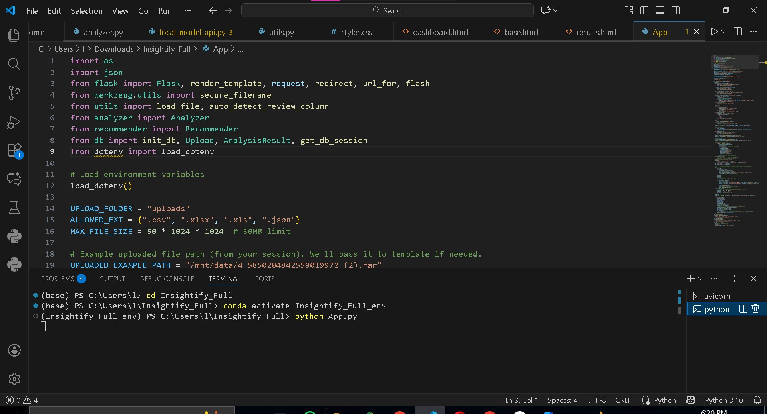

Slide 9
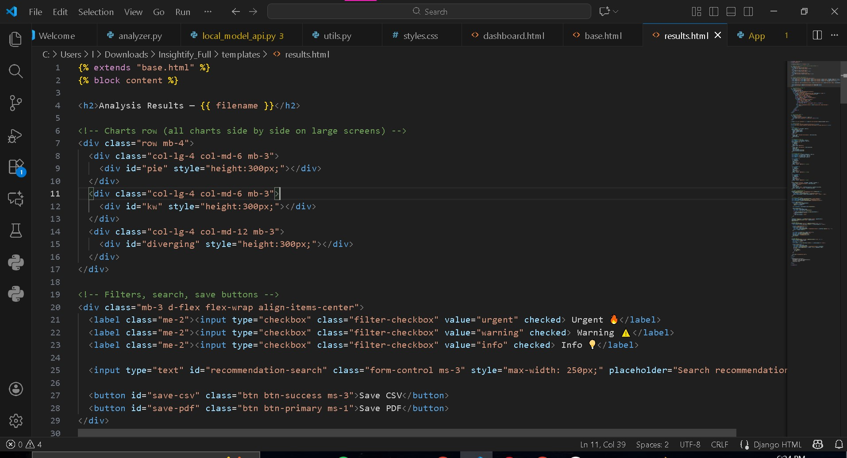

Slide 10
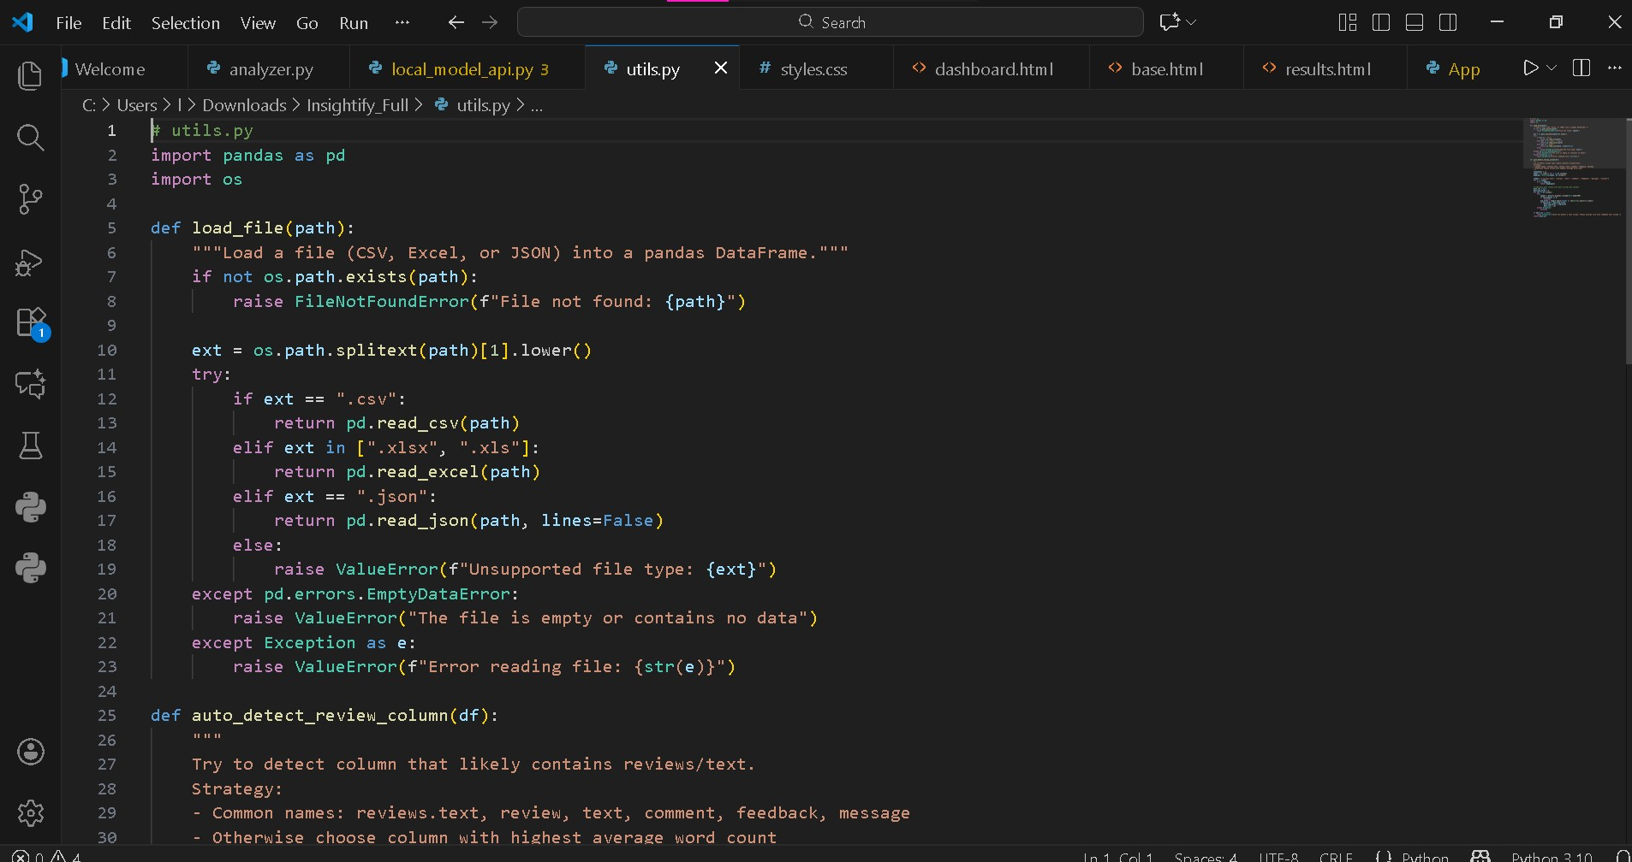

Slide 11
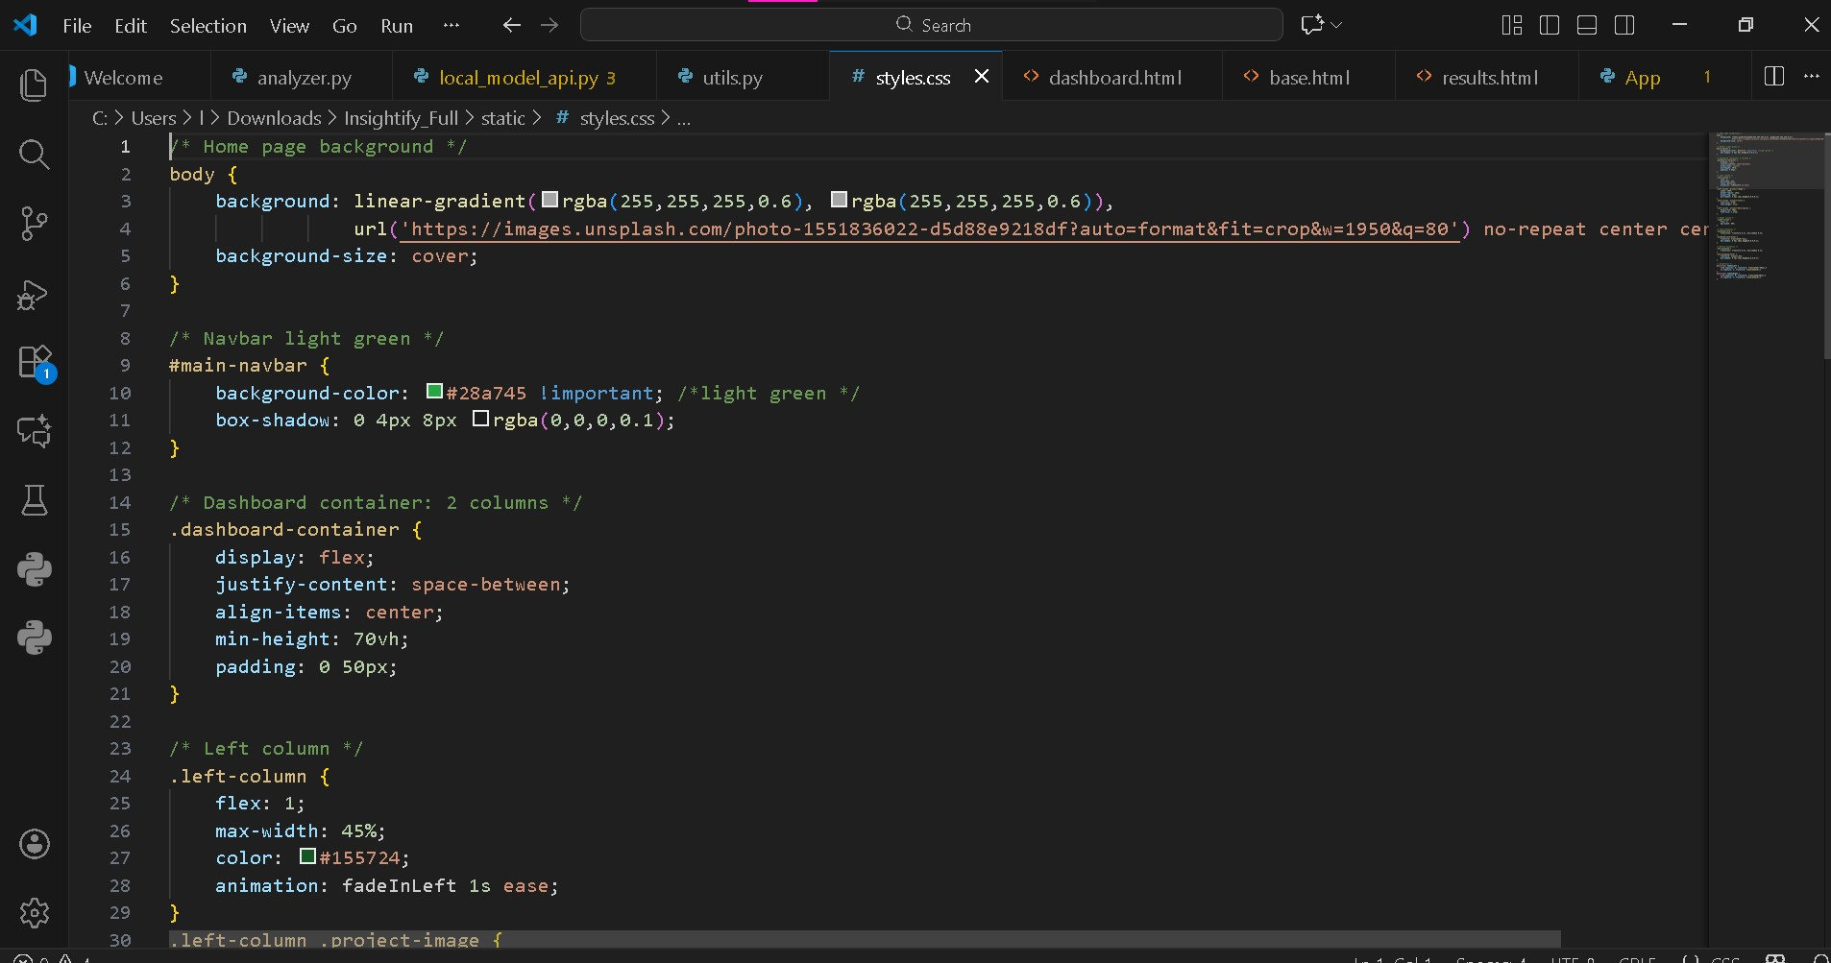

Slide 12





















Key Features — Data Upload and Preprocessing
Multiple File Format Support
Automatic Review Column Detection
CSV files
Excel spreadsheets
Intelligent column identification
JSON data
Handles various column names
Confirms selection accuracy
Data Cleaning Capabilities
Data Preparation for Analysis
Handles missing values
Text normalization
Standardizes inconsistent data
Prepares for sentiment analysis
Removes duplicates
Readies for keyword extraction
Insightify_Full — AI Review Analyzer
Page 8 of 16

Slide 13
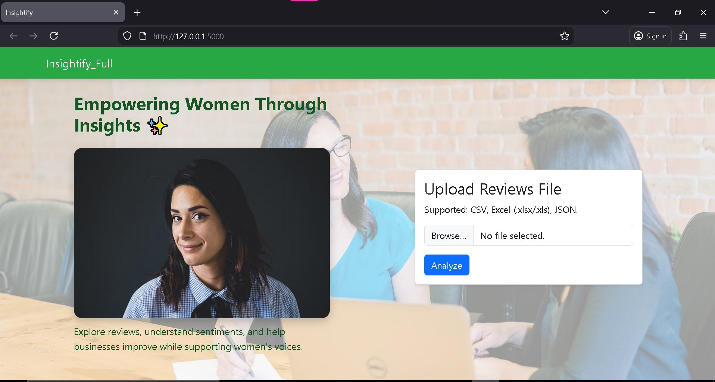

Slide 14








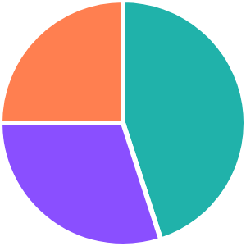

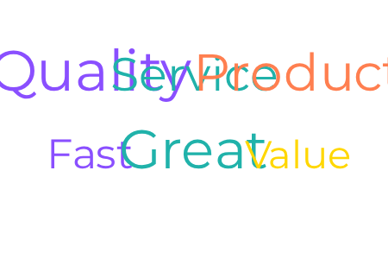














Key Features — Analysis Options
Sentiment Analysis
Visualizations
VADER: Quick sentiment analysis for speed
Sentiment Distribution
Keyword Cloud
BERT: Deep understanding of context and nuance
Interactive pie charts showing positive, negative, and neutral sentiment
Dynamic word clouds highlighting frequent terms
Keyword Extraction
Export Options
Identify most frequent terms in reviews
Detect product mentions and attributes
CSV Format
PDF Reports
Database
For spreadsheet analysis
For presentations
For future reference

Slide 15
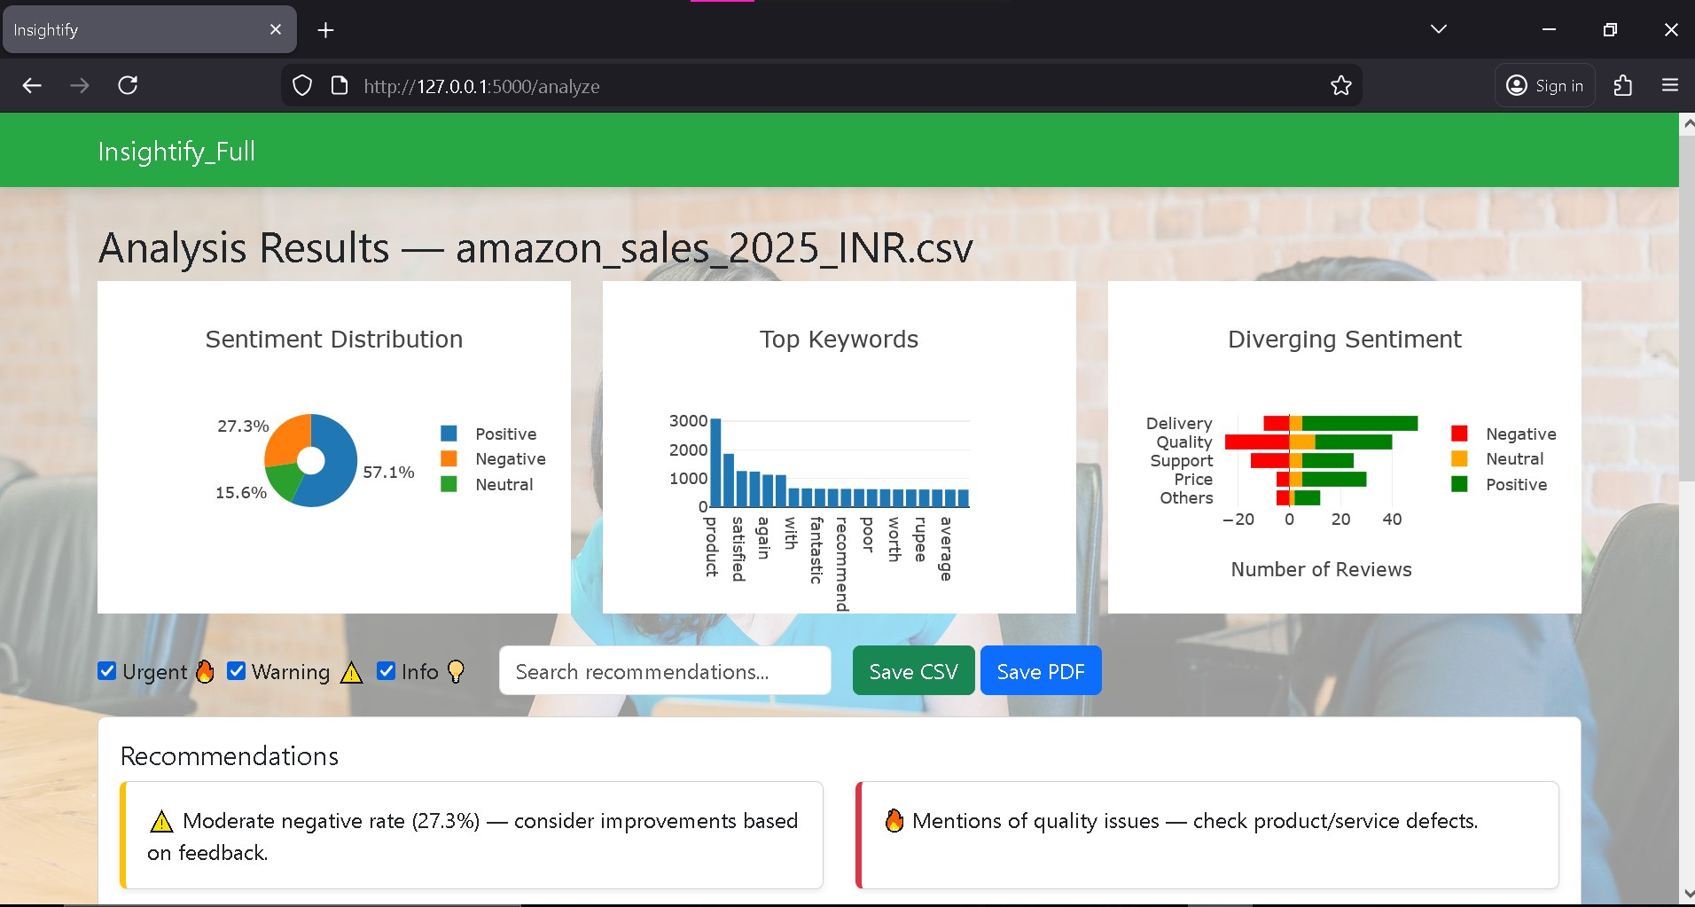

Slide 16
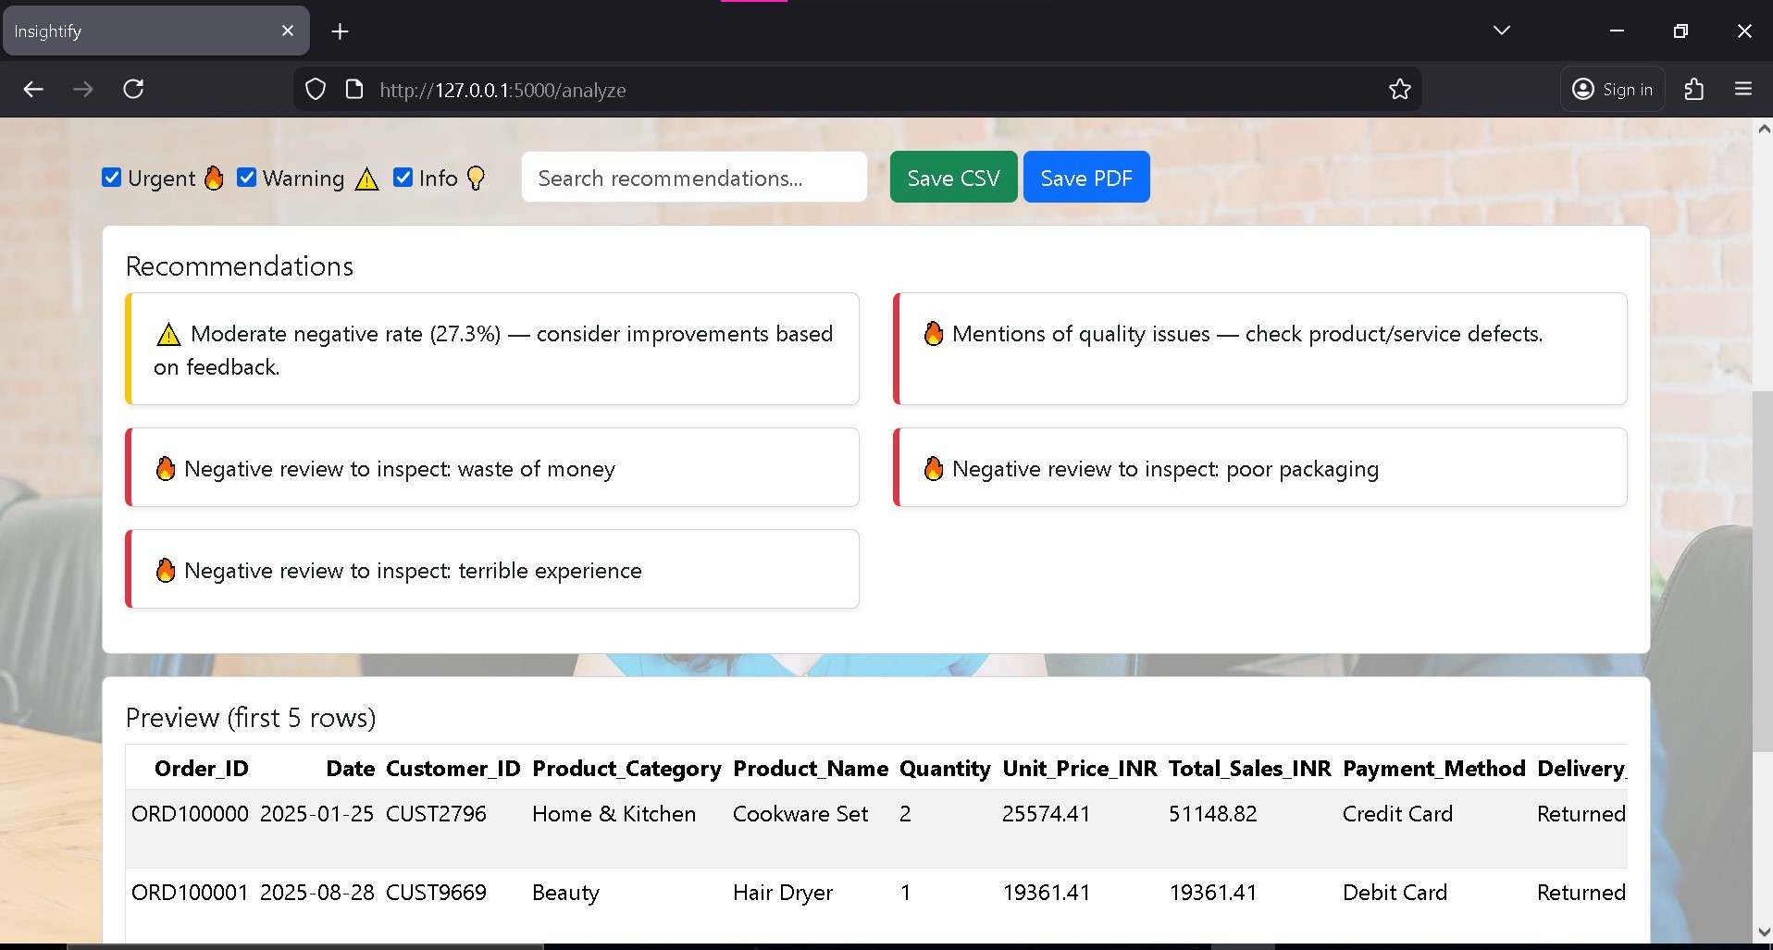

Slide 17
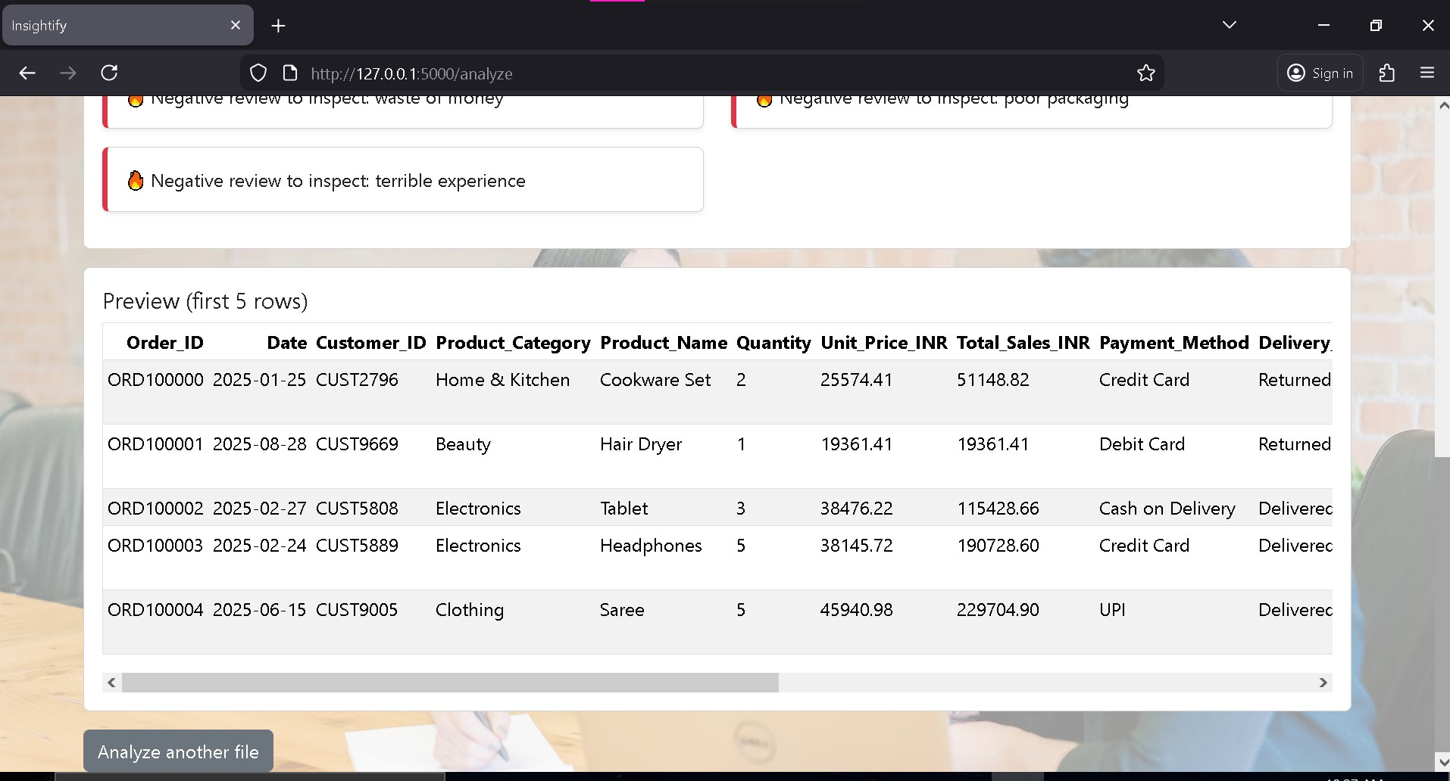

Slide 18






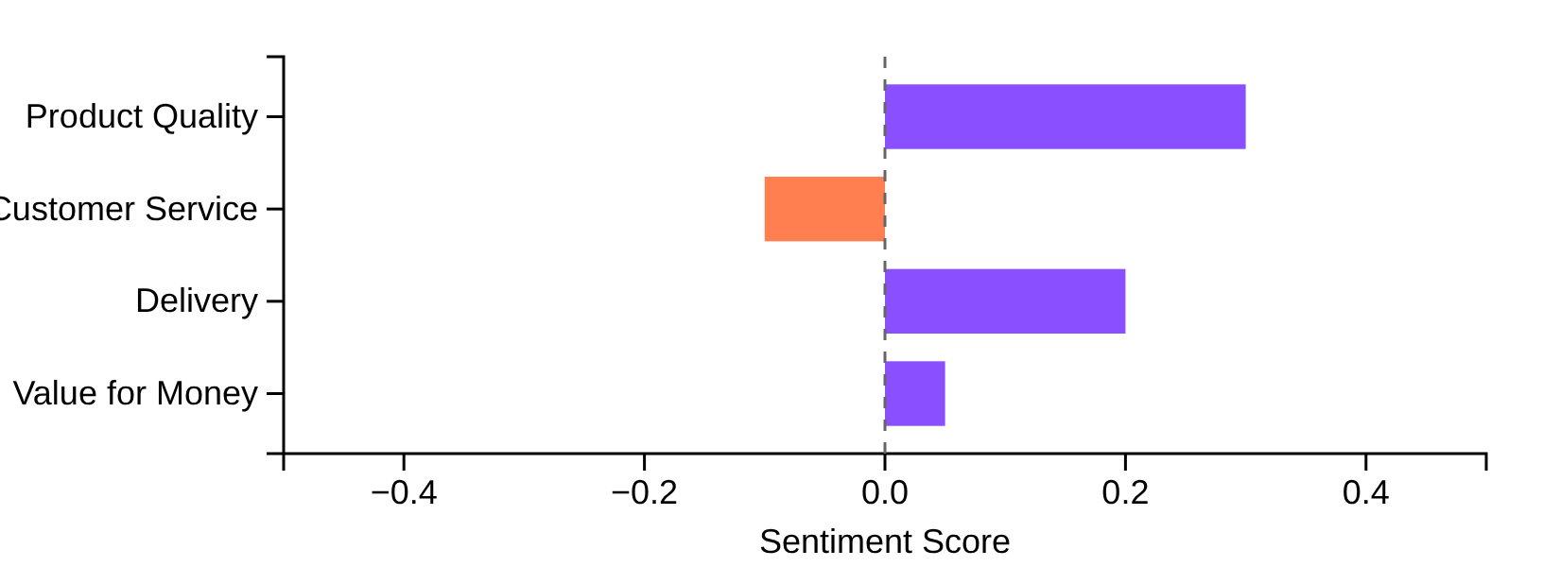














Key Features — Insights and Outputs
Sentiment Analysis
Sample Interactive Chart
Summarizes positive, negative, and neutral sentiment counts from review datasets, providing a quick overview of customer sentiment.
Keyword Identification
Highlights trending keywords and product mentions, helping identify the most discussed aspects in customer reviews.
Interactive Charts
Positive
Negative
Neutral
Provides interactive visualizations for exploring patterns in review data, enabling users to drill down into specific aspects of customer feedback.
Output Export Options:
CSV
PDF
Database
Output Storage
Saves analysis outputs for future comparison and reporting, allowing users to track sentiment trends and keyword evolution over time.

Slide 19



















Challenges and Solutions
Technical hurdles overcome to create an efficient AI review analysis tool
Processing Large Datasets
Optimized Data Handling
Efficiently handling large review datasets
Used pandas and numpy for efficient data processing
AI Integration
Modular Architecture
Integrating local BERT model with Flask and FastAPI
Separated AI tasks into modules for seamless integration
Interactive Visualizations
Scalable Visualization
Generating dynamic visualizations from review data
Implemented Plotly and wordcloud for dynamic insights
Insightify_Full — AI Review Analyzer
11/16

Slide 20
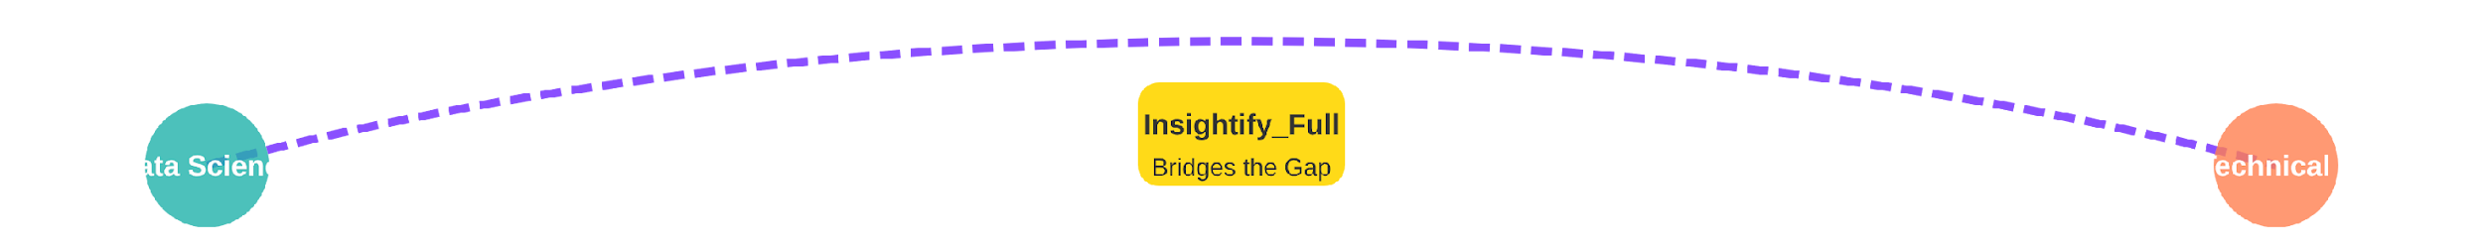









Added Value and Innovation
Dual AI Sentiment Analysis
Multiple File Format Support
VADER for quick results, BERT for deep understanding - combining speed and accuracy for comprehensive insights.
Accepts CSV, Excel, and JSON uploads - ensuring compatibility with various data sources and workflows.
Interactive, Exportable Insights
Bridging the Data Gap
Generate interactive charts and export results to CSV, PDF, or database for comprehensive analysis.
Empower non-technical users with AI-driven insights, making data science accessible to everyone.
Women in Tech Program - Paper Airplanes
12/16

Slide 21



















Live Demonstration Plan
See Insightify_Full in action with a complete workflow demonstration:
1. Upload Dataset
2. Data Processing
3. Analysis
4. Visualization
5. Export Results
Upload CSV/Excel/JSON review data
Auto-detect review column & clean data
Run sentiment analysis & extract keywords
Display interactive plots & word cloud
Export to CSV & store in database
Key Demonstration Highlights
Dual AI analysis (VADER + BERT)
Interactive visualizations
Export options (CSV, PDF, DB)
Insightify_Full — AI Review Analyzer
Page 13 of 16

Slide 22













Future Enhancements
Planned improvements to enhance Insightify_Full's capabilities and user experience:
Optimize for Larger Datasets
Recommendation Engine
Enhance processing capabilities to handle thousands of reviews efficiently, enabling analysis of larger business datasets.
Implement a product recommendation system based on sentiment trends and user preferences derived from review analysis.
Multi-language Support
Mobile-friendly Interface
Add support for global e-commerce reviews by enabling analysis of reviews in multiple languages beyond English.
Develop a responsive design allowing users to perform review analysis and access insights on mobile devices for on-the-go analysis.
Insightify_Full — AI Review Analyzer
Page 14 of 16

Slide 23

















Conclusion and Acknowledgments
Conclusion
Acknowledgments
Insightify_Full simplifies review analysis for mid-size datasets, making complex data accessible.
Tutor
Mulham Fetna
Combines AI, NLP, and visualization to transform raw reviews into actionable insights.
Mentor
Jaafer Mahfoud
Enables data-driven decision-making without requiring programming expertise.
Program
Women in Tech Program - Paper Airplanes
Every insight represents a curious mind's dedication to knowledge
Thank you for your guidance and support
Insightify_Full — AI Review Analyzer
15/16

Slide 24
























References
Backend
Data Handling
Flask (core)
pandas
FastAPI (AI integration)
numpy
openpyxl
AI & NLP
Visualization
VADER (sentiment analysis)
Transformers (BERT)
Plotly
NLTK
wordcloud
scikit-learn
Additional Technologies
SQLAlchemy
psycopg2
requests
python-dotenv
Women in Tech Program - Paper Airplanes
Page 16 of 16

